Slide 1
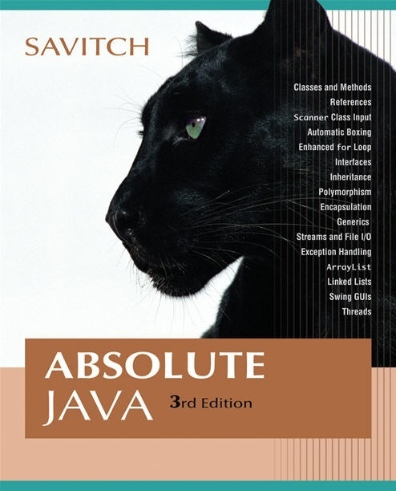


Chapter 4
Defining Classes I
Copyright © 2008 Pearson Addison-Wesley. All rights reserved

Slide 2
Introduction
Classes are the most important language feature that make object-oriented programming (OOP) possible
Programming in Java consists of defining a number of classes
  Every program is a class
  All helping software consists of classes
  All programmer-defined types are classes
Classes are central to Java
Copyright © 2008 Pearson Addison-Wesley. All rights reserved
4-<number>

Slide 3
Class Definitions
You already know how to use classes and the objects created from them, and how to invoke their methods
  For example, you have already been using the predefined String and Scanner classes
Now you will learn how to define your own classes and their methods, and how to create your own objects from them
Copyright © 2008 Pearson Addison-Wesley. All rights reserved
4-<number>

Slide 4
A Class Is a Type
A class is a special kind of programmer-defined type, and variables can be declared of a class type
A value of a class type is called an object or an instance of the class
  If A is a class, then the phrases "bla is of type A," "bla is an object of the class A," and "bla is an instance of the class A" mean the same thing
A class determines the types of data that an object can contain, as well as the actions it can perform
Copyright © 2008 Pearson Addison-Wesley. All rights reserved
4-<number>

Slide 5
Primitive Type Values vs. Class Type Values
A primitive type value is a single piece of data
A class type value or object can have multiple pieces of data, as well as actions called methods
  All objects of a class have the same methods
  All objects of a class have the same pieces of data (i.e., name, type, and number)
  For a given object, each piece of data can hold a different value
Copyright © 2008 Pearson Addison-Wesley. All rights reserved
4-<number>

Slide 6
The Contents of a Class Definition
A class definition specifies the data items and methods that all of its objects will have
These data items and methods are sometimes called members of the object
Data items are called fields or instance variables
Instance variable declarations and method definitions can be placed in any order within the class definition
Copyright © 2008 Pearson Addison-Wesley. All rights reserved
4-<number>

Slide 7
Sample Class Definition
public class DateFirstTry
{
public String month;
public int day;
public int year; //a four digit number.
public void writeOutput( )
{
System.out.println(month + " " + day + ", " + year);
}
}
4-<number>

Slide 8
The new Operator
An object of a class is named or declared by a variable of the class type:
  ClassName classVar;
  DateFirstTry birthDay;
The new operator must then be used to create the object and associate it with its variable name:
  classVar = new ClassName();
  birthDay = new DateFirstTry ( );
These can be combined as follows:
  ClassName classVar = new ClassName();
  DateFirstTry birthDay = new DateFirstTry ( );
Copyright © 2008 Pearson Addison-Wesley. All rights reserved
4-<number>

Slide 9
Instance Variables and Methods
Instance variables can be defined as in the following two examples
  Note the public modifier (for now):
  public String instanceVar1;
  public int instanceVar2;
In order to refer to a particular instance variable, preface it with its object name as follows:
  objectName.instanceVar1
  objectName.instanceVar2
  birthday.month;
  birthday.day;
  Birthday.year;
Copyright © 2008 Pearson Addison-Wesley. All rights reserved
4-<number>

Slide 10
Creating Objects
DateFirstTry date1, date2;
date1 = new DateFirstTry( );
date2 = new DateFirstTry( );
date1.month = "December";
date1.day = 31;
date1.year = 2007;
date2.month = "July";
date2.day = 4;
date2.year = 1776;
4-<number>

Slide 11
Instance Variables and Methods
Method definitions are divided into two parts: a heading and a method body:
  public void myMethod() Heading
  {
  code to perform some action Body
  and/or compute a value
  }
Methods are invoked using the name of the calling object and the method name as follows:
  classVar.myMethod();
  date1.writeOutput( );
Invoking a method is equivalent to executing the method body
Copyright © 2008 Pearson Addison-Wesley. All rights reserved
4-<number>

Slide 12
File Names and Locations
Reminder: a Java file must be given the same name as the class it contains with an added .java at the end
  For example, a class named MyClass must be in a file named MyClass.java
For now, your program and all the classes it uses should be in the same directory or folder
Copyright © 2008 Pearson Addison-Wesley. All rights reserved
4-<number>

Slide 13
Invoking Methods
date1.writeOutput( );
date2.writeOutput( );
4-<number>

Slide 14
Sample Driver (Application Program)
public class DateFirstTryDemo
{
public static void main(String[] args)
{
DateFirstTry date1, date2;
date1 = new DateFirstTry( );
date2 = new DateFirstTry( );
date1.month = "December";
date1.day = 31;
date1.year = 2007;
System.out.println("date1:");
date1.writeOutput( );
date2.month = "July";
date2.day = 4;
date2.year = 1776;
System.out.println("date2:");
date2.writeOutput( );
}
}
4-<number>

Slide 15
More About Methods
There are two kinds of methods:
  Methods that compute and return a value
  Methods that perform an action
    This type of method does not return a value, and is called a void method
Each type of method differs slightly in how it is defined as well as how it is (usually) invoked
Copyright © 2008 Pearson Addison-Wesley. All rights reserved
4-<number>

Slide 16
More About Methods
A method that returns a value must specify the type of that value in its heading:
public typeReturned methodName(paramList)
public int getDay( ){
return day;
}
A void method uses the keyword void in its heading to show that it does not return a value : public void methodName(paramList)
public void writeOutput( )
Copyright © 2008 Pearson Addison-Wesley. All rights reserved
4-<number>

Slide 17
main is a void Method
A program in Java is just a class that has a main method
When you give a command to run a Java program, the run-time system invokes the method main
Note that main is a void method, as indicated by its heading:
  public static void main(String[] args)
Copyright © 2008 Pearson Addison-Wesley. All rights reserved
4-<number>

Slide 18
return Statements
The body of both types of methods contains a list of declarations and statements enclosed in a pair of braces
  public <void or typeReturned> myMethod()
  {
  declarations Body
  statements
  }
Copyright © 2008 Pearson Addison-Wesley. All rights reserved
4-<number>

Slide 19
return Statements
The body of a method that returns a value must also contain one or more return statements
  A return statement specifies the value returned and ends the method invocation:
  return Expression;
  Expression can be any expression that evaluates to something of the type returned listed in the method heading
Copyright © 2008 Pearson Addison-Wesley. All rights reserved
4-<number>

Slide 20
return Statements
A void method need not contain a return statement, unless there is a situation that requires the method to end before all its code is executed
In this context, since it does not return a value, a return statement is used without an expression:
  return;
Copyright © 2008 Pearson Addison-Wesley. All rights reserved
4-<number>

Slide 21
Sample method
public void readInput( )
{
Scanner keyboard = new Scanner(System.in);
System.out.println("Enter month, day, and year.");
System.out.println("Do not use a comma.");
month = keyboard.next( );
day = keyboard.nextInt( );
year = keyboard.nextInt( );
}
4-<number>

Slide 22
Another Sample Method
public int getMonth( )
{
if (month.equalsIgnoreCase("January"))
return 1;
else if (month.equalsIgnoreCase("February"))
return 2;
else if (month.equalsIgnoreCase("March"))
return 3;
.
.
else if (month.equalsIgnoreCase("December"))
return 12;
else
{
System.out.println("Fatal Error");
System.exit(0);
return 0; //Needed to keep the compiler happy
}
}
4-<number>

Slide 23
Method Definitions
An invocation of a method that returns a value can be used as an expression anyplace that a value of the typeReturned can be used:
  typeReturned tRVariable;
  tRVariable = objectName.methodName();
  int birthMonth = date1.getMonth();
An invocation of a void method is simply a statement:
  objectName.methodName();
  date1.readInput();
Copyright © 2008 Pearson Addison-Wesley. All rights reserved
4-<number>

Slide 24
Any Method Can Be Used As a void Method
A method that returns a value can also perform an action
If you want the action performed, but do not need the returned value, you can invoke the method as if it were a void method, and the returned value will be discarded:
objectName.returnedValueMethod();
  System.out.println(date1.getMonth());
Copyright © 2008 Pearson Addison-Wesley. All rights reserved
4-<number>

Slide 25
Invoking Methods
DateSecondTry date = new DateSecondTry( );
date.readInput( );
int dayNumber = date.getDay( );
System.out.println("That is the " + dayNumber + "th day of the month.");
4-<number>

Slide 26
Demo Sample Program: dateSecondTry
dateSecondTry.java: Class Definition of dateSecondTry
DemoOfDateSecondTry: Driver (Application program) of dateSecondTry
4-<number>

Slide 27
Local Variables
A variable declared within a method definition is called a local variable
  All variables declared in the main method are local variables
  All method parameters are local variables
If two methods each have a local variable of the same name, they are still two entirely different variables
Copyright © 2008 Pearson Addison-Wesley. All rights reserved
4-<number>

Slide 28
Global Variables
Some programming languages include another kind of variable called a global variable
The Java language does not have global variables
Copyright © 2008 Pearson Addison-Wesley. All rights reserved
4-<number>

Slide 29
Blocks
A block is another name for a compound statement, that is, a set of Java statements enclosed in braces,{}
A variable declared within a block is local to that block, and cannot be used outside the block
Once a variable has been declared within a block, its name cannot be used for anything else within the same method definition
Copyright © 2008 Pearson Addison-Wesley. All rights reserved
4-<number>

Slide 30
Declaring Variables in a for Statement
You can declare one or more variables within the initialization portion of a for statement
A variable so declared will be local to the for loop, and cannot be used outside of the loop
If you need to use such a variable outside of a loop, then declare it outside the loop
Copyright © 2008 Pearson Addison-Wesley. All rights reserved
4-<number>

Slide 31
Declaring Variables in a for Statement
(an example)
  int rowNum, columnNum;
  for (rowNum = 1; rowNum <=3; rowNum++)
  {
  for (columnNum = 1; columnNum <=2;
  columnNum++)
  System.out.print(" row " + rowNum +
  " column " + columnNum);
  System.out.println();
  }
4-<number>

Slide 32
Parameters of a Primitive Type
The methods seen so far have had no parameters, indicated by an empty set of parentheses in the method heading
Some methods need to receive additional data via a list of parameters in order to perform their work
  These parameters are also called formal parameters
Copyright © 2008 Pearson Addison-Wesley. All rights reserved
4-<number>

Slide 33
Parameters of a Primitive Type
A parameter list provides a description of the data required by a method
  It indicates the number and types of data pieces needed, the order in which they must be given, and the local name for these pieces as used in the method
public double myMethod(int p1, int p2, double p3)
  Example:
  int a=1,b=2,c=3;
  double result = myMethod(a,b,c);
Copyright © 2008 Pearson Addison-Wesley. All rights reserved
4-<number>

Slide 34
Parameters of a Primitive Type
When a method is invoked, the appropriate values must be passed to the method in the form of arguments
  Arguments are also called actual parameters
The number and order of the arguments must exactly match that of the parameter list
The type of each argument must be compatible with the type of the corresponding parameter
  int a=1,b=2,c=3;
  double result = myMethod(a,b,c);
Copyright © 2008 Pearson Addison-Wesley. All rights reserved
4-<number>

Slide 35
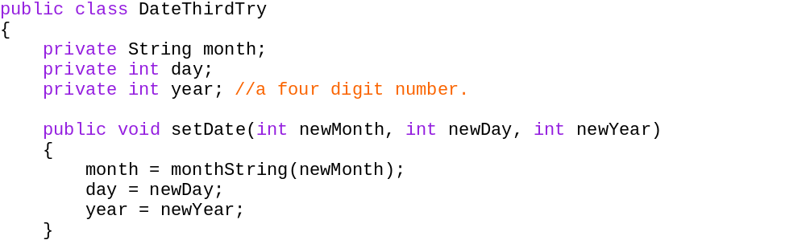
Sample Method with Parameters
4-<number>

Slide 36
Invoking Method with Parameters
DateThirdTry date ;
date = new DateThirdTry( );
int year = 1882;
date.setDate(6, 17, year);
Demo: DateThirdTry
4-<number>

Slide 37
Parameters of a Primitive Type
In the preceding example, the value of each argument (not the variable name) is plugged into the corresponding method parameter
  This method of plugging in arguments for formal parameters is known as the call-by-value mechanism
Copyright © 2008 Pearson Addison-Wesley. All rights reserved
4-<number>

Slide 38
Parameters of a Primitive Type
If argument and parameter types do not match exactly, Java will attempt to make an automatic type conversion
  In the preceding example, the int value of argument c would be cast to a double
  A primitive argument can be automatically type cast from any of the following types, to any of the types that appear to its right:
  byte→short→int→long→float→double
  char
Copyright © 2008 Pearson Addison-Wesley. All rights reserved
4-<number>

Slide 39
Parameters of a Primitive Type
A parameters is often thought of as a blank or placeholder that is filled in by the value of its corresponding argument
However, a parameter is more than that: it is actually a local variable
When a method is invoked, the value of its argument is computed, and the corresponding parameter (i.e., local variable) is initialized to this value
Even if the value of a formal parameter is changed within a method (i.e., it is used as a local variable) the value of the argument cannot be changed
Copyright © 2008 Pearson Addison-Wesley. All rights reserved
4-<number>

Slide 40
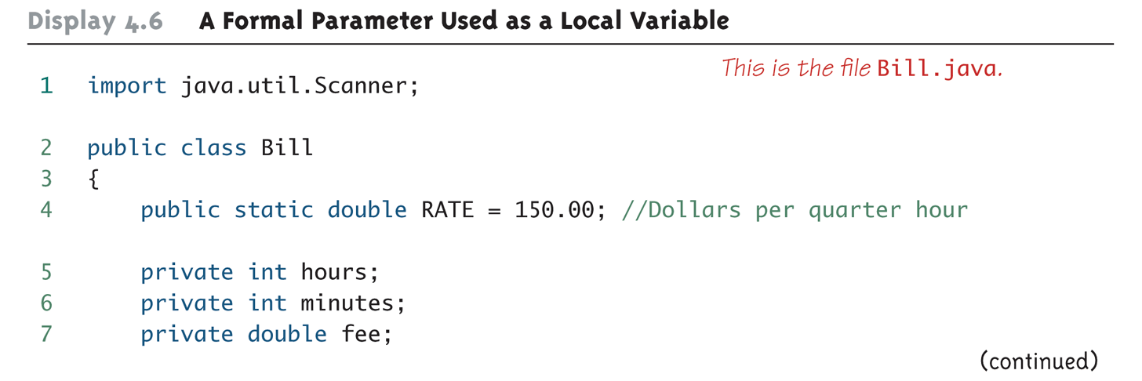
A Formal Parameter Used as a Local Variable (Part 1 of 5)
Copyright © 2008 Pearson Addison-Wesley. All rights reserved
4-<number>

Slide 41
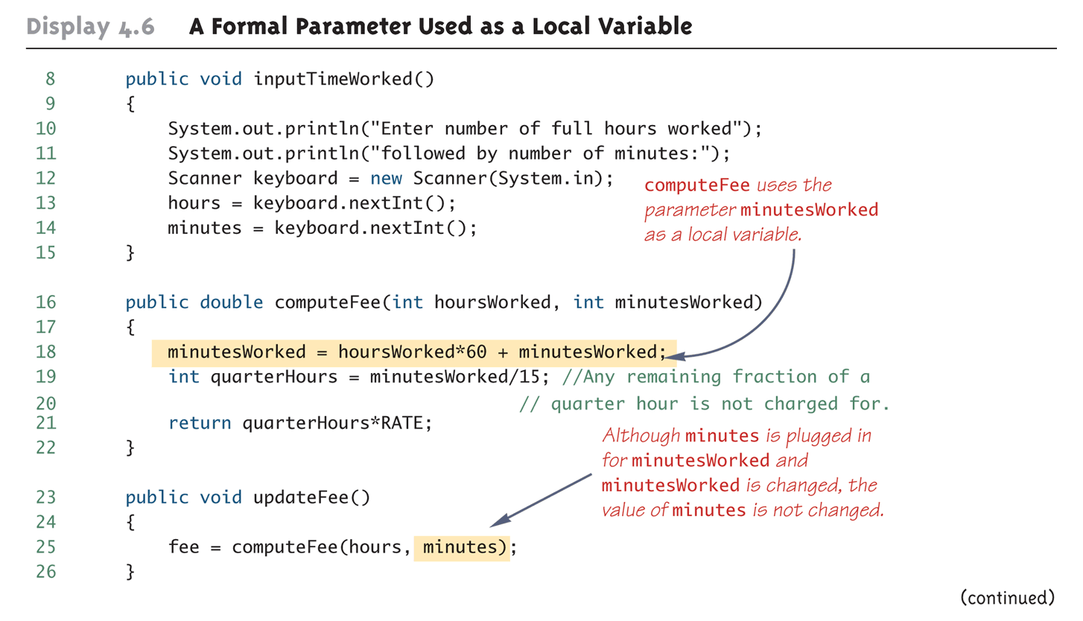
A Formal Parameter Used as a Local Variable (Part 2 of 5)
Copyright © 2008 Pearson Addison-Wesley. All rights reserved
4-<number>

Slide 42
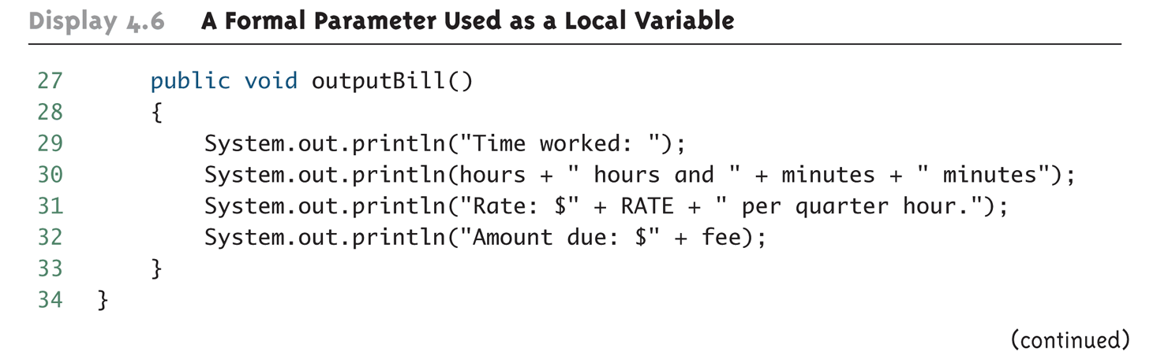
A Formal Parameter Used as a Local Variable (Part 3 of 5)
Copyright © 2008 Pearson Addison-Wesley. All rights reserved
4-<number>

Slide 43
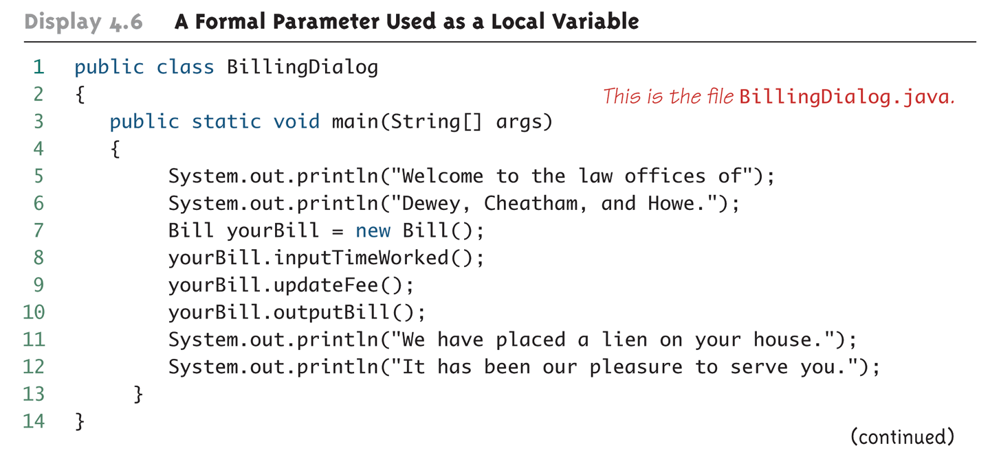
A Formal Parameter Used as a Local Variable (Part 4 of 5)
Copyright © 2008 Pearson Addison-Wesley. All rights reserved
4-<number>

Slide 44
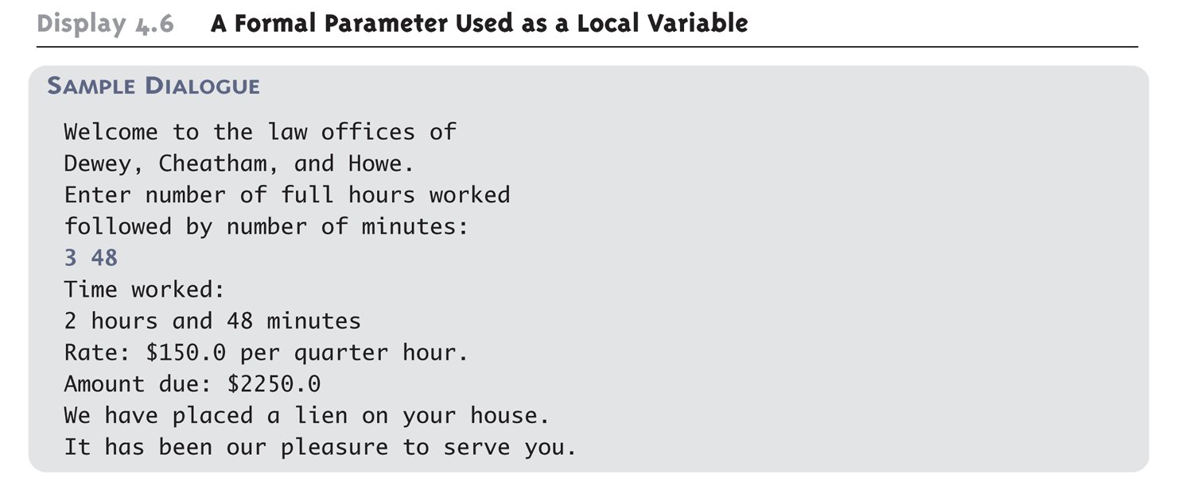
A Formal Parameter Used as a Local Variable (Part 5 of 5)
Copyright © 2008 Pearson Addison-Wesley. All rights reserved
4-<number>

Slide 45
Pitfall: Use of the Terms "Parameter" and "Argument"
Do not be surprised to find that people often use the terms parameter and argument interchangeably
When you see these terms, you may have to determine their exact meaning from context
Copyright © 2008 Pearson Addison-Wesley. All rights reserved
4-<number>

Slide 46
The this Parameter
All instance variables are understood to have <the calling object>. in front of them
If an explicit name for the calling object is needed, the keyword this can be used
  myInstanceVariable always means and is always interchangeable with this.myInstanceVariable
Copyright © 2008 Pearson Addison-Wesley. All rights reserved
4-<number>

Slide 47
An example of Using this Parameter
DateSecondTry date;
date = new DateSecondTry( );
date.writeOutput( );
4-<number>

Slide 48
public void writeOutput( )
{
System.out.println(month + " " + day + ", " + year);
}
public void writeOutput( )
{
System.out.println(this.month + " " + this.day + ", " + this.year);
}
==========================================
public void writeOutput( )
{
System.out.println(date.month + " " + date.day +
", " + date.year);
}
Note: this refers to the calling object
4-<number>

Slide 49
The this Parameter
this must be used if a parameter or other local variable with the same name is used in the method
  Otherwise, all instances of the variable name will be interpreted as local
  int someVariable = this.someVariable
local
instance
Copyright © 2008 Pearson Addison-Wesley. All rights reserved
4-<number>

Slide 50
An example of when this parameter must be used
public class DateThirdTry
{
private String month;
private int day;
private int year; //a four digit number.
public void setDate(int newMonth, int newDay, int newYear)
{
month = monthString(newMonth);
day = newDay;
year = newYear;
}
//In Driver
DateThirdTry date1 = new DateThirdTry();
date1. setDate (3, 20, 2012);
4-<number>

Slide 51
public class DateThirdTry
{
private String month;
private int day;
private int year; //a four digit number.
public void setDate(int month, int day, int year) //not correct
{
//all refer to local variables
month = monthString(month);
day =day;
year = year;
}
© 2006 Pearson Addison-Wesley. All rights reserved
4-<number>

Slide 52
public class DateThirdTry {
private String month;
private int day;
private int year; //a four digit number.
public void setDate(int month, int day, int year) //correct
{
this.month = monthString(month);
this.day =day;
this.year = year;
}
© 2006 Pearson Addison-Wesley. All rights reserved
4-<number>

Slide 53
public class DateThirdTryDemo {
public static void main(String[] args) {
DateThirdTry date;
date = new DateThirdTry( );
int month = 6;
int day = 17;
int year = 1882;
date.setDate(month, day, year);
date.writeOutput( );
}
}
//demo dateThirdTryDemo
4-<number>

Slide 54
The this Parameter
The this parameter is a kind of hidden parameter
Even though it does not appear on the parameter list of a method, it is still a parameter
When a method is invoked, the calling object is automatically plugged in for this
Copyright © 2008 Pearson Addison-Wesley. All rights reserved
4-<number>

Slide 55
Methods That Return a Boolean Value
An invocation of a method that returns a value of type boolean returns either true or false
Therefore, it is common practice to use an invocation of such a method to control statements and loops where a Boolean expression is expected
  if-else statements, while loops, etc.
Copyright © 2008 Pearson Addison-Wesley. All rights reserved
4-<number>

Slide 56
The methods equals and toString
Java expects certain methods, such as equals and toString, to be in all, or almost all, classes
The purpose of equals, a boolean valued method, is to compare two objects of the class to see if they satisfy the notion of "being equal"
  Note: You cannot use == to compare objects
  public boolean equals(ClassName objectName)
The purpose of the toString method is to return a String value that represents the data in the object
  public String toString()
Copyright © 2008 Pearson Addison-Wesley. All rights reserved
4-<number>

Slide 57
Testing Methods
Each method should be tested in a program in which it is the only untested program
  A program whose only purpose is to test a method is called a driver program
One method often invokes other methods, so one way to do this is to first test all the methods invoked by that method, and then test the method itself
  This is called bottom-up testing
Sometimes it is necessary to test a method before another method it depends on is finished or tested
  In this case, use a simplified version of the method, called a stub, to return a value for testing
Copyright © 2008 Pearson Addison-Wesley. All rights reserved
4-<number>

Slide 58
The Fundamental Rule for Testing Methods
Every method should be tested in a program in which every other method in the testing program has already been fully tested and debugged
Copyright © 2008 Pearson Addison-Wesley. All rights reserved
4-<number>

Slide 59
Information Hiding and Encapsulation
Information hiding is the practice of separating how to use a class from the details of its implementation
  Abstraction is another term used to express the concept of discarding details in order to avoid information overload
Encapsulation means that the data and methods of a class are combined into a single unit (i.e., a class object), which hides the implementation details
  Knowing the details is unnecessary because interaction with the object occurs via a well-defined and simple interface
  In Java, hiding details is done by marking them private
Copyright © 2008 Pearson Addison-Wesley. All rights reserved
4-<number>

Slide 60
A Couple of Important Acronyms:
API and ADT
The API or application programming interface for a class is a description of how to use the class
  A programmer need only read the
  API in order to use a well designed class
An ADT or abstract data type is a data type that is written using good information-hiding techniques
Copyright © 2008 Pearson Addison-Wesley. All rights reserved
4-<number>

Slide 61
public and private Modifiers
The modifier public means that there are no restrictions on where an instance variable or method can be used
The modifier private means that an instance variable or method cannot be accessed by name outside of the class
It is considered good programming practice to make all instance variables private
Most methods are public, and thus provide controlled access to the object
Usually, methods are private only if used as helping methods for other methods in the class (see method dateOk used in setDate in the class DateFifthTry)
Copyright © 2008 Pearson Addison-Wesley. All rights reserved
4-<number>

Slide 62
Accessor and Mutator Methods
Accessor methods allow the programmer to obtain the value of an object's instance variables
  The data can be accessed but not changed
  The name of an accessor method typically starts with the word get
Mutator methods allow the programmer to change the value of an object's instance variables in a controlled manner
  Incoming data is typically tested and/or filtered
  The name of a mutator method typically starts with the word set
Copyright © 2008 Pearson Addison-Wesley. All rights reserved
4-<number>

Slide 63
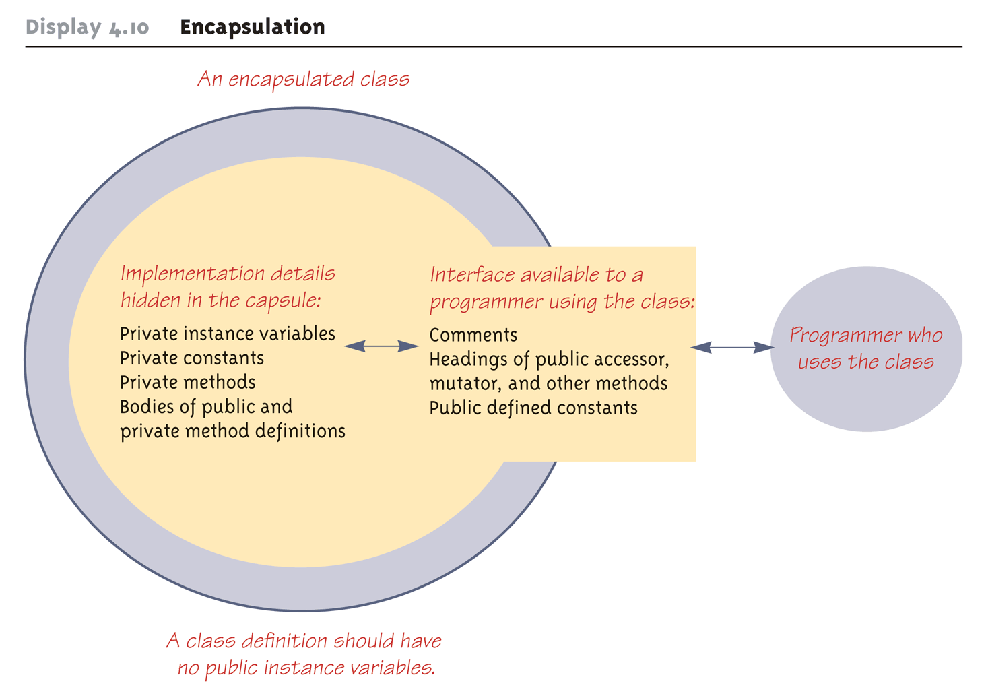
Encapsulation
Copyright © 2008 Pearson Addison-Wesley. All rights reserved
4-<number>

Slide 64
Preconditions and Postconditions
The precondition of a method states what is assumed to be true when the method is called
The postcondition of a method states what will be true after the method is executed, as long as the precondition holds
It is a good practice to always think in terms of preconditions and postconditions when designing a method, and when writing the method comment
Copyright © 2008 Pearson Addison-Wesley. All rights reserved
4-<number>

Slide 65
Overloading
Overloading is when two or more methods in the same class have the same method name
To be valid, any two definitions of the method name must have different signatures
  A signature consists of the name of a method together with its parameter list
  Differing signatures must have different numbers and/or types of parameters (see setDate in DateSixthTry)
Copyright © 2008 Pearson Addison-Wesley. All rights reserved
4-<number>

Slide 66
Pitfall: You Can Not Overload Based on the Type Returned
The signature of a method only includes the method name and its parameter types
  The signature does not include the type returned
Java does not permit methods with the same name and different return types in the same class
Copyright © 2008 Pearson Addison-Wesley. All rights reserved
4-<number>

Slide 67
Constructors
A constructor is a special kind of method that is designed to initialize the instance variables for an object:
  public ClassName(anyParameters){code}
  A constructor must have the same name as the class
  A constructor has no type returned, not even void
  Constructors are typically overloaded (see class Date)
Copyright © 2008 Pearson Addison-Wesley. All rights reserved
4-<number>

Slide 68
Constructors
A constructor is called when an object of the class is created using new
  ClassName objectName = new ClassName(anyArgs);
  The name of the constructor and its parenthesized list of arguments (if any) must follow the new operator
  This is the only valid way to invoke a constructor: a constructor cannot be invoked like an ordinary method
If a constructor is invoked again (using new), the first object is discarded and an entirely new object is created
  If you need to change the values of instance variables of the object, use mutator methods instead
Copyright © 2008 Pearson Addison-Wesley. All rights reserved
4-<number>

Slide 69
You Can Invoke Another Method in a Constructor
The first action taken by a constructor is to create an object with instance variables
Therefore, it is legal to invoke another method within the definition of a constructor, since it has the newly created object as its calling object
  For example, mutator methods can be used to set the values of the instance variables
  It is even possible for one constructor to invoke another
Copyright © 2008 Pearson Addison-Wesley. All rights reserved
4-<number>

Slide 70
A Constructor Has a this Parameter
Like any ordinary method, every constructor has a this parameter
The this parameter can be used explicitly, but is more often understood to be there than written down
The first action taken by a constructor is to automatically create an object with instance variables
Then within the definition of a constructor, the this parameter refers to the object created by the constructor
Copyright © 2008 Pearson Addison-Wesley. All rights reserved
4-<number>

Slide 71
Include a No-Argument Constructor
If you do not include any constructors in your class, Java will automatically create a default or no-argument constructor that takes no arguments, performs no initializations, but allows the object to be created
If you include even one constructor in your class, Java will not provide this default constructor
If you include any constructors in your class, be sure to provide your own no-argument constructor as well (see ConstructorsDemo)
Copyright © 2008 Pearson Addison-Wesley. All rights reserved
4-<number>

Slide 72
Default Variable Initializations
Instance variables are automatically initialized in Java
  boolean types are initialized to false
  Other primitives are initialized to the zero of their type
  Class types are initialized to null
However, it is a better practice to explicitly initialize instance variables in a constructor
Note: Local variables are not automatically initialized
Review of class definition and driver: see Pet and PetDemo
Copyright © 2008 Pearson Addison-Wesley. All rights reserved
4-<number>

Slide 73
The StringTokenizer Class
The StringTokenizer class is used to recover the words or tokens in a multi-word String
  You can use whitespace characters to separate each token, or you can specify the characters you wish to use as separators
  In order to use the StringTokenizer class, be sure to include the following at the start of the file:
  import java.util.StringTokenizer;
  See StringTokenizerDemo
Copyright © 2008 Pearson Addison-Wesley. All rights reserved
4-<number>

Slide 74
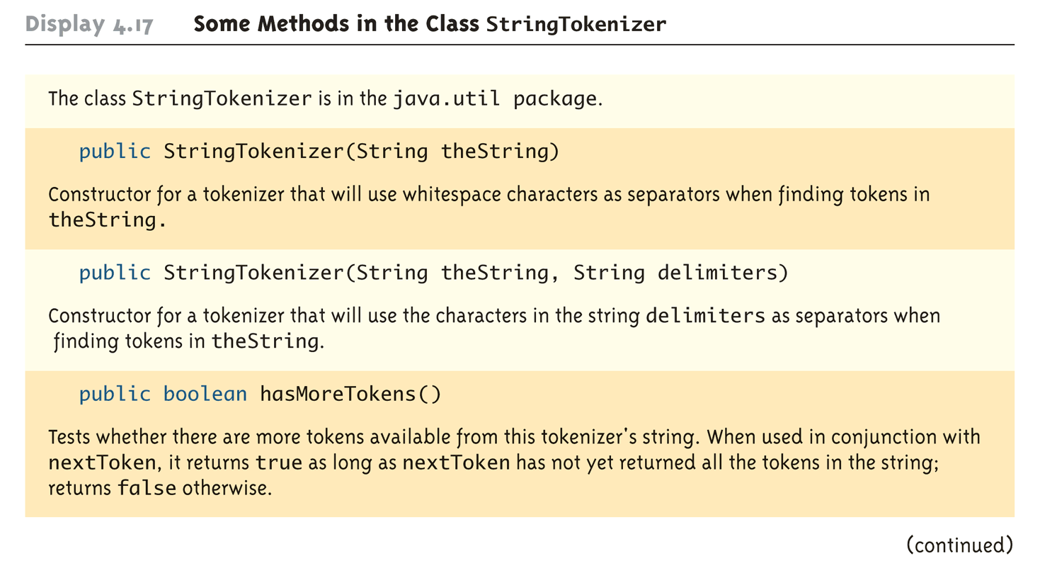
Some Methods in the StringTokenizer Class (Part 1 of 2)
Copyright © 2008 Pearson Addison-Wesley. All rights reserved
4-<number>

Slide 75
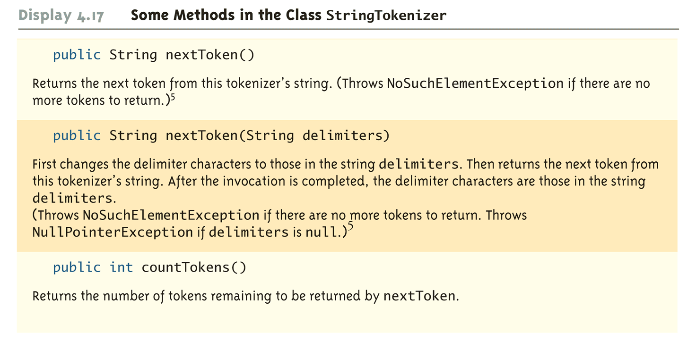
Some Methods in the StringTokenizer Class (Part 2 of 2)
Copyright © 2008 Pearson Addison-Wesley. All rights reserved
4-<number>

Slide 76
Go over Lab on Employee class
4-<number>

